Slide 1
TEXT EXTRACTION FROM IMAGE+TEXT TO SPEECH
By:
SIDDHI SHEWALE
ANIKET MORE
ANUSHKA GIRISH
NANDINI SAHU
Guided by:
Dr. P.D Patil

Slide 2


IMAGE TO A TEXT AND SPEECH CONVERTER

Slide 3
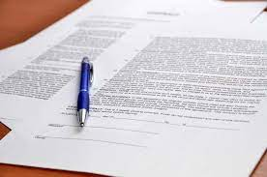


Introduction
Image to text:
People deal with chunks of information daily. Much data nowadays is sent in the form of images or scanned documents. Many situations require editing of data sent in the form of images. Thus, we need tools to convert these documents into editable forms. Optical character recognition is one of the popular techniques used for this purpose

Slide 4
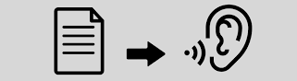

Introduction
Text to speech:
The extracted text can be converted into audio for easier usage, which will save time of reading the document and increases user engagement since the document is available in both text and audio.
TTS (text-to-speech) software used for this purpose.

Slide 5
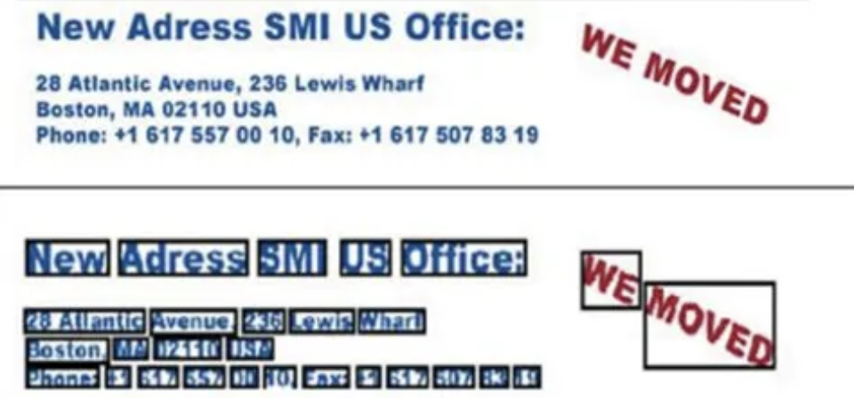
Literature Survey
Text data can be embedded in an image in different font styles, sizes, orientations, colors, and against a complex background, the problem of extracting the candidate text region becomes a challenging one
A Text Information Extraction system receives an input in the form of a still image or a sequence of images.
(i) Detection
Text detection refers to the determination of the presence of text in a given sequence of images.
(ii) Localization
Text localization is the process of determining the location of text in the image and generating bounding boxes around the text.
Notes:
Thik hai kya?

Slide 6
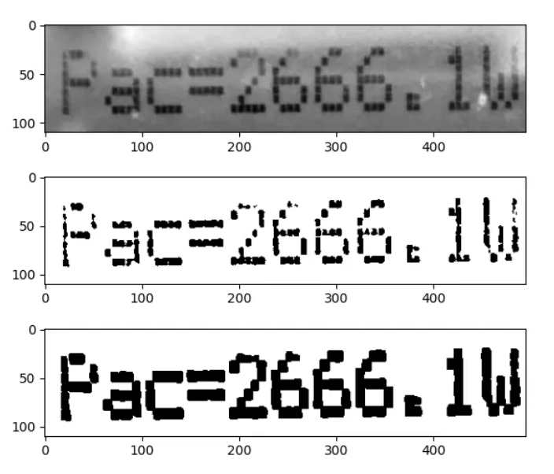
iii) Tracking
Text tracking is performed to reduce the processing time for text localization and to maintain the
integrity of position across adjacent frames.
(iv) Extraction and Enhancement
Although the precise location of text in an image can be indicated by bounding boxes, the text needs to be segmented from the background to facilitate its recognition. That means, the extracted text image has to be converted into a binary image and enhanced before it is fed into an OCR engine.
Text extraction is the stage where the text components
are segmented from the background. Text Enhancement
of the extracted text components is required because
the text region usually has low resolution and is horizontal
to noise.
(v) Recognition (OCR).
Thereafter, the extracted text images can be
transformed into plain text using OCR technology.

Slide 7
Scope
Before the invention of OCR, converting physical text to digital was a manual effort: a person would have to retype each document, a time-consuming task prone to mistakes. With OCR, the conversion happens quickly and with greater fidelity to the original content.
In digital form of hardcopy , viewers can edit, format, search the document.
This eliminates the need for physical storage space, a cost-savings for businesses that heavily rely on documentation, such as legal firms.
TTS also offers many benefits for content owners and publishers as well. This feature immediately increase the accessibility of online content for those with visual impairments or reading difficulties
It facilitates access for a larger percentage of the online population and makes it easier in general for all people to access online content on mobile devices

Slide 8
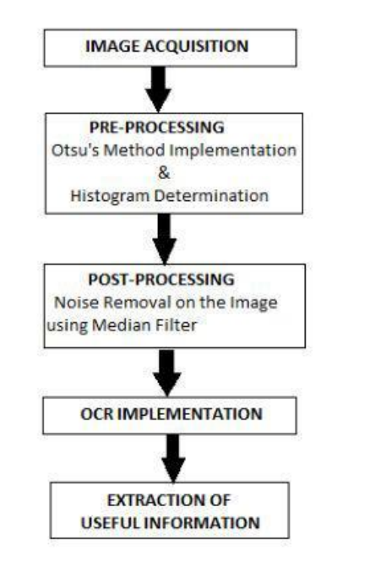
System Architecture

Slide 9
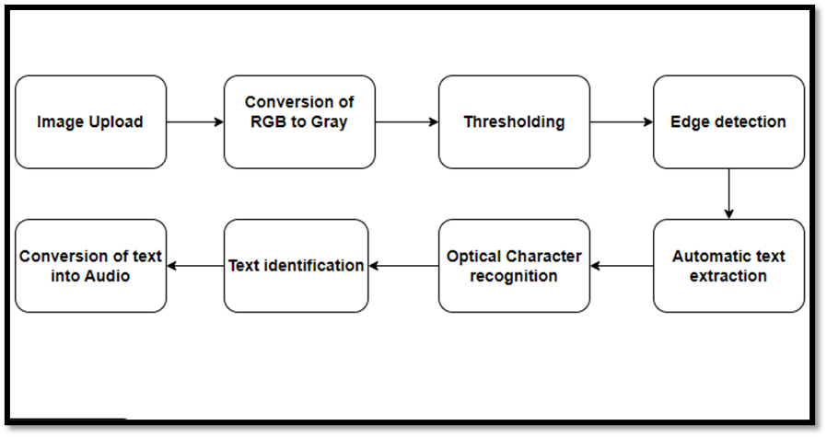
Flowchart

Slide 10
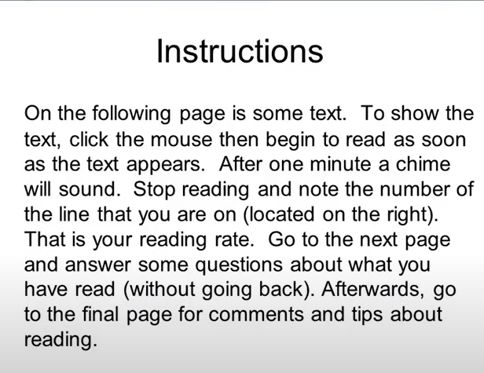
Input Image

Slide 11
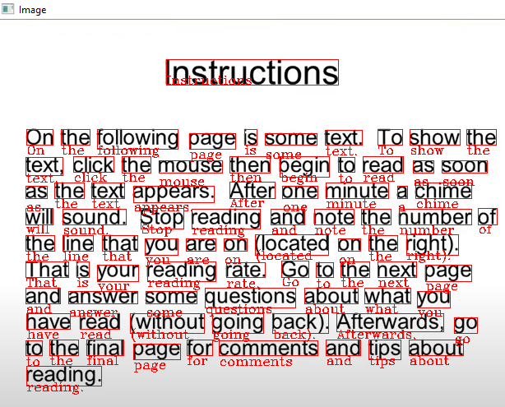
Detected text

Slide 12
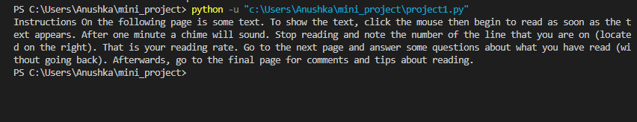
Extracted text

Slide 13

Audio file of the text named ‘sound.mp3’

Slide 14
Social Aspect of Project:
Image to text using OCR is applicable to many types of businesses. There are many practical, commercial uses for OCR technology, from data entry and automatic recognition, to the conversion of handwritten data
Ocr can hence be used in:
Banking
Educational Institutes
Healthcare
Tourism and Hospitality
Retail

Slide 15
Social Aspect of Project:
Text-to-Speech makes it easier in general for all people to access online content on mobile devices, increases citizen engagement and strengthens corporate social responsibility by ensuring that information is available in both written and audio format.
Advantages:
The system is helpful for persons having learning disabilities or people who prefer to listen rather than read.
Prevents eye from strain, and user can sit and listen comfortably.
Saves time especially while driving, exercising.
Easy to use.
Help improving spelling, reading, writing skills.

